Slide 1

LEADERSHIP
&
MOTIVATION
Resource Person:
Syed Hussain Haider
Principal Management Consultant
University of Central Punjab
Email: s_h_haider2003@yahoo.com.hk

Slide 2
“Nothing can with stand the power of a determined and resolute mind –barriers fall,everything succumbs---if positively inspired the very gates of heaven open”.

Slide 3
Pakistan & Global
Environment

Slide 4
GLOBAL ENVIRONMENT
Time Management
Hierarchies
Standardization
Accountability & Analysis
Non Conformity
Continuous
Improvement
Pointing
Finger
Continuous
Process
Managing
Deterioration
Orientation
Morale
No
Individual
Orientation
Management
Value
of Morale
Fixing Vs.
Finger Pointing
Addition
Non-
functional
training
Performance
Team Management
Productivity
GLOBAL
PRESENT
You
Value
Depletion
Responsibility
ENVIRONMENT
ENVIRONMENT
for Outcomes
Belief Systems
Slow
Continuous
Learning
Speed
No Responsibility
Certainty and indecisive
Functional
Training
Ambiguity &
Meritocracy
School
Learning only
Quick Change
Uncertainty
No Change
and no
Mgmt audits
Knowledge Management
Activity
Resource Management
Traceability

Slide 5
SOP of Human Mind
Development of Values & Belief Systems
Environment
Destiny
Religion
Culture
Character
Habits
Family
Organization
Actions
OUTPUT
Words
OUTPUT
Feelings
Dreams
Ideas Thoughts
FEEDBACK
FEEDBACK
Values
Mind
Brain
Belief Systems

Slide 6
Pakistan vs. Singapore
Pakistan:
Independence 1947
Population 150 m
Area 796,000 sq.km.
N.Resources: Many
Econ.results: (-)
Budgeted Expenses for Education: 2.1%
Singapore:
Independence 1965
Population 4 m
Area 685 sq.km.
N.Resources: Zero
Econ.result: (+)
Budgeted Investment for Education: 30%

Slide 7
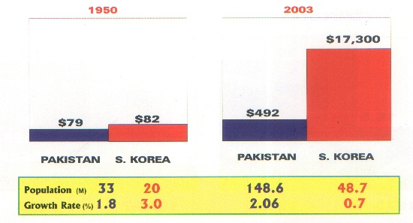
PER CAPITA INCOME OF PAKISTAN AND S.KOREA
1950 - 2003

Slide 8





Sequence of Change
When you change your EXPERIENCE
You change your THNKING
When you change your THINKING
You change your BELIEFS
When you change your BELIEFS
You change your EXPECTATIONS
When you change your EXPECTATIONS
You change your ATTITUDE
When you change your ATTITUDE
You change your BEHAVIOUR
When you change your BEHAVIOUR
You change your PERFORMANCE
When you change your PERFORMANCE
You change your LIFE !

Slide 9
PRODUCTIVITY DEFINED
Productivity = outputs * (within a Time
Inputs period and at a
specific Quality level)
Productivity is also affected by the external factors as well.

Slide 10
Personal Productivity is to!
Think critically ‘Critical Thinking’
Think creatively ‘Creative Thinking’
Make accurate decision ‘Decision Making’
Managing time efficiently ‘Time Management’

Slide 11
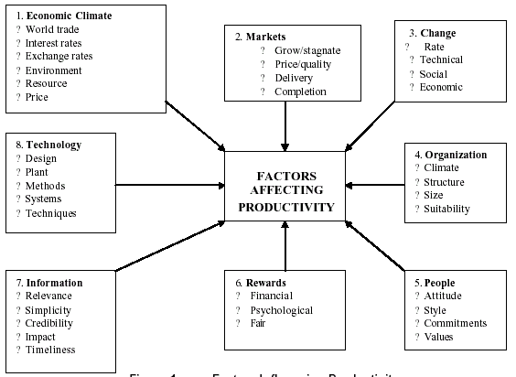
Factors Influencing Productivity

Slide 12
HIERARCHY OF GOALS
VISION – Values – Verve (Positive Enthusiasm)
MISSION
GOALS
OBJECTIVES
PERFORMANCE TARGETS

Slide 13
DEFINITIONS OF LEADERSHIP
Leadership is “the behavior of an individual when he is directing the activities of a group toward a shared goal.” (Hamphill & Coons, 1975)
Leadership is “interpersonal influence, exercised in a situation, and directed, through the communication process, toward the attainment of a specified goal or goals.” (Tannenbaum, Wesehler & Massarilc, 1961)

Slide 14
DEFINITION OF LEADERSHIP
Leadership is “the initiation and maintenance of structure in expectation and interaction”. (stogdill, 1974)
Leadership is “the influential increment over and above mechanical compliance with the routine directives of the organization”. (Kaiz & Kain, 1978)
Leadership is “the process of influencing the vities of an organized group toward goal achievement”. (Rauch & Beh , 1981)

Slide 15
DEFINITION OF LEADERSHIP
Leadership is a process of giving purpose (meaning full direction) to collective effort, and causing willing effort to be expended to achieve purpose. (jaco’s & Jaques, 1990)
Leadership are those who consistently write effective contributions to social order, and who are expected and perceive to do so. (Hos’dag, 1988)

Slide 16
DEFINITION OF LEADERSHIP
Leadership is defined broadly as influence processes affecting the interpretation of events for followers, the choice of objectives for the groups or organization, the organization of work activities to accomplish the objective, the motivation of followers to achieve the objectives, the maintenance of cooperative relationship and teamwork, and the enlistment of support and cooperation from people outside the group or organization. (Gray Yuid, 1994)

Slide 17
DEFINITION OF LEADERSHIP
Beside influence, leadership has been defined in terms of group processes, personality, compliance, particular behaviours, persuasion, power, goal achievement, interaction, role differentiation, initiation of structure and combinations of two or more of these.
I don’t go where the puck is; I go to where the puck is going to be.

Slide 18
Challenges
Porter
Strategic Thinking
McKinsey
Leadership
Empathy
Emotional
Intelligence
Self Awareness
Team Dynamics
Synergy

Slide 19
Synergy
The combined action of two or more which have a greater total effect than the sum of their individual effects.
OR
The working together of two or more muscles, organs or drugs.
Zynergy
  Cooperacy
  Optimal Utilization of Resources
  Energized Synergy

Slide 20
MCKINSEY’S 7- S MODEL
Structure
Strategy
System
Shared
Vision
Skills
Style
Staff

Slide 21


The problem facing almost all leaders in the future will be how to develop their organisation's social architecture so that it actually generates intellectual capital.

Slide 22
Casual Chain of Effects by A Leader
Articulate Appealing Vision
Increased Followers Commitment
Increased Followers Effort
Increased Quality & Productivity
Increased Result

Slide 23

VISIONARY LEADERSHIP
THE ABILITY TO CREATE AND ARTICULATE A REALISTIC, CREDIBLE, ATTRACTIVE VISION OF THE FUTURE FOR AN ORGANISATION OR UNIT THAT GROWS OUT OF AND IMPROVES UPON THE PRESENT
  Stephen P. Robbins

Slide 24
VISION: reflection
has a clear and compelling imagery that offers an innovative way to improve
draws on tradition and connects to actions that people can take to realize change.
taps people’s emotions and energy
creates enthusiasm , energy and commitment

Slide 25
VISION
The key properties of a vision are
inspirational,
based on values,
realizable and unique,
offering a new order that can produce organizational distinction.

Slide 26

THE LEADERSHIP CHALLENGE
A COMPELLING VISION
They are concerned with the organization's basic purpose, its existence, sand not with the “how to”or “nuts and bolts” of the operation. They are leaders, more than managers.

Slide 27
THE LEADERSHIP CHALLENGE
POWERFUL, NOT THROUGH DOMINATION, BUT THROUGH THEIR CAPACITY TO MOBILISE PEOPLE AND RESOURCES TO GET THINGS DONE.

Slide 28

THE LEADERSHIP CHALLENGE
THE LEADER MUST EXEMPLIFY THE HIGHEST VALUES OF THE ORGANIZATION

Slide 29
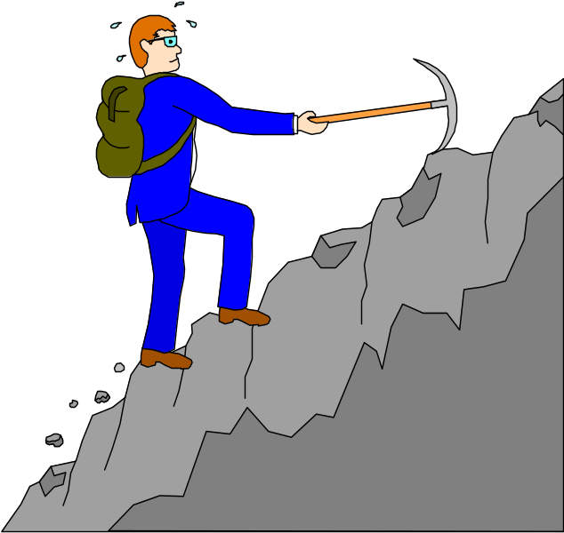
THE LEADERSHIP CHALLENGE
THE LEADER MUST PROVIDE ENTREPRENEURIAL IMAGINATION FOR THE ORGASNISATION - risk taking

Slide 30

THE LEADERSHIP CHALLENGE
THE EFFECTIVE LEADER IS A TRANSFORMING LEADER -- CAPABLE OF DIRECTING PEOPLE THROUGH FUNDAMENTAL CHANGE - values, etc.

Slide 31
LEADERSHIP TRAITS
DRIVE: achievement, ambition, energy, initiative
LEADERSHIP MOTIVATION
HONESTY & INTEGRITY
SELF CONFIDENCE: EMOTIONAL STABILITY
COGNITIVE ABILITY: intelligence; perception
KNOWLEDGE

Slide 32
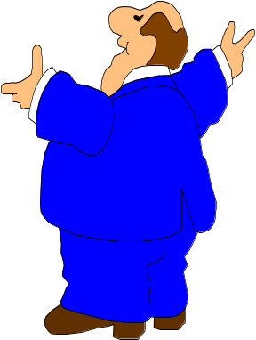
INSPIRING LEADER
Rewards
Encourages
Listens; open minded to new ideas
Tells ‘how” and ‘why’
Considerate
Consistent
Caring
Firm but fair
Appreciative
Assumes “best” in others
Appreciates effort
offers guidelines
Keeps subordinates informed
Persuasive
WE
CAN

Slide 33

COERCIVE BOSS
Threatens
Finds fault
Keeps people guessing
Tells others what to do
Blunt
Flaunts authority
Takes advantage of others
Impulsive
Thankless
Assumes worst in people
Goal centred

Slide 34
THE TEN COMMANDEMENTS
Analyze the organization and its need for change
Create a shared vision and common direction
Separate from the past
Create a strong sense of urgency
Support a strong leader role
Line up political sponsorship
Craft an implementation plan
Develop enabling structures
Communicate, involve people, and be honest
Reinforce and institutionalize change

Slide 35
MOTIVATIONAL PROCESSES

Slide 36
What is Motivation
Positive action made to achieve a goal.
or
Stimulate the interest of a person in an activity.
or
Encourage a person to act in a particular way.

Slide 37
THE MEANING OF MOTIVATION
Today, virtually all people – practitioners and scholars – have their own definitions of motivation. Usually one or more of the following words are included:
desires, wants, wishes, aims, goals, needs, drives, motives, and incentives.
Technically, the term motivation can be traced to the Latin word movere, which means “to move,” This meaning is evident in the following comprehensive definition:
“Motivation is a process that starts with a physiological or psychological deficiency or need that activates a behavior or a drive that is aimed at a goal or incentive. Thus, the key to understanding the process of motivation lies in the meaning of, and relationships among, needs, drives, and incentives”.

Slide 38
MOTIVATION SUMMARY
  Extrinsic and Intrinsic.
  Setting Goals.
  Time Management .
  Develop Positive Attitude.
  Fear of Failure.
  Rewarding Yourself.

Slide 39
Extrinsic (short-term) – When you are motivated externally
through merits and rewards such as money,gifts,or even fear
of punishment ,social or economic pressure. Motivation is triggered from outside factor.
Intrinsic (long-term) – You can be motivated internally by interest ,natural curiosity, or the desire to explore new ideas, this motivation drives them internally and independently.

Slide 40
SET YOUR GOALS
Determine what your needs and wants are.
Make your goals realistic.
Set short –term goals that will help to accomplish your
long-term goals.
SMART

Slide 41
Manage your time wisely
Make the most of your time.
Prioritize goals.
Complete as many tasks as possible.
Are you reaching your daily goals? Monthly goals?
yearly goals?

Slide 42
Develop a positive attitude
Encourage yourself.
Praise your talent, positive traits and abilities.
Develop an “I can” attitude.
Avoid negative labeling.
Drop self-blame yourself for past mistakes.

Slide 43
Reward yourself
While pursuing long-term goals, it is smart to give yourself
simple gifts as rewards for taking small steps

Slide 44
Fear of Failure
Fear of failure.
To overcome any fear, look at the current situation –not as
a problem, but as a fresh opportunity.
Break things down into small parts.

Slide 45
Create & Post
Sight Triggers
Choose a meaningful
Role Model
Use Audio Triggers
Self-Motivation
Techniques
Do not sit Idle
List
Potential Gain
and Loss
Maintain a visual progress
Chart
Break Mega tasks into
Mini tasks
Declare a
Deadline
SWOT
Determination

Slide 46
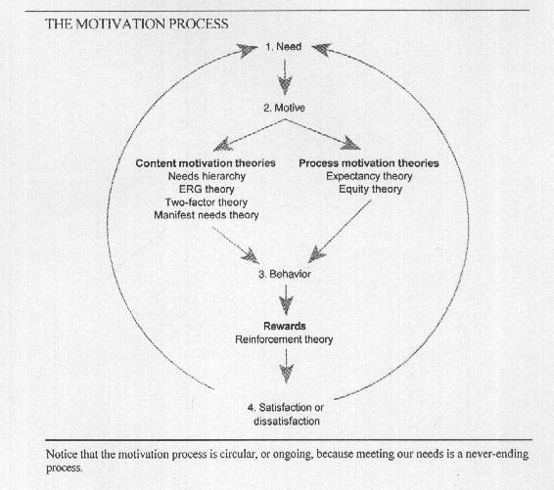

Slide 47
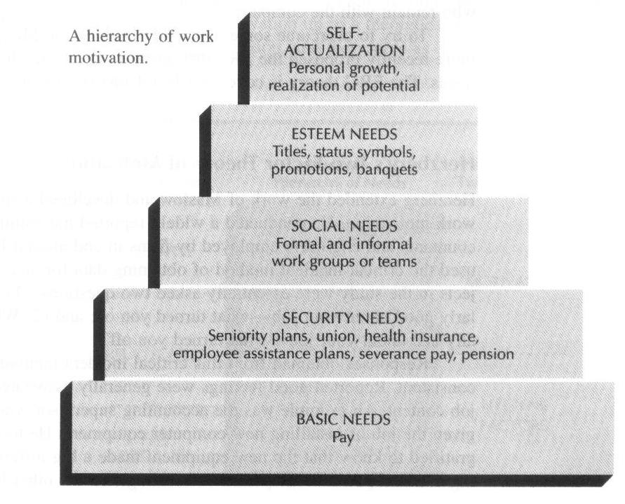

Slide 48
Leadership based on spirituality
Spiritual Soul → SQ?
Emotional Heart → EQ
Intellectual Mind → IQ
Physical Body → PQ
SOUL
HEART
MIND
BODY

Slide 49
THE TOP 20 WAYS TO MOTIVATE EMPLOYEES
(#1) Give employees the information they need to do a good job
(#2) Provide regular feedback
(#3) Ask employees for their input, involve them in decisions that affect their jobs
(#4) establish easy-to-use channels of communication that employees can use to express their questions and concerns and get answers
(#5) Earn from the employees than solves what is that motivates them
(#6) learn what on-the-job activities employees choose to do when they have free time
(#7) Personally congratulate employees for a job well done
(#8) Recognize the power of their physical presence
(#8) Write personal notes in them about their performance
(#10) Publicly recognize employees for good work

Slide 50
(#11) Include morale-building meetings that celebrate group success
(#12) Give them a good job to do
(#13) Have the tools available to do their best work
(#14) Recognizing employee’s personal needs
(#15) Strong performance as the basis for promotion
(#16) Establish a comprehensive, promote-from within policy.
(#17) Emphasizing the organization’s commitment to long-term employment
(#18) Fosters a sense of community
(#19) Pay people competitively based on what they are worth
(#20) Giving them a financial reason to excel by offering them a share of the profits

Slide 51
THE TOP DEMOTIVATORS
Offering “jelly-bean” rewards
That is, giving everyone-regardless of individual performance – the same rewards at the end of the year
Not being specific or timely about praise; for example, telling people they did a good job on a project that was completed two months earlier and neglecting to tell them why the job was good
Using threats or coercion to get work done
Breaking a promise
Treating employees in a bureaucratic way instead of as individuals

Slide 52
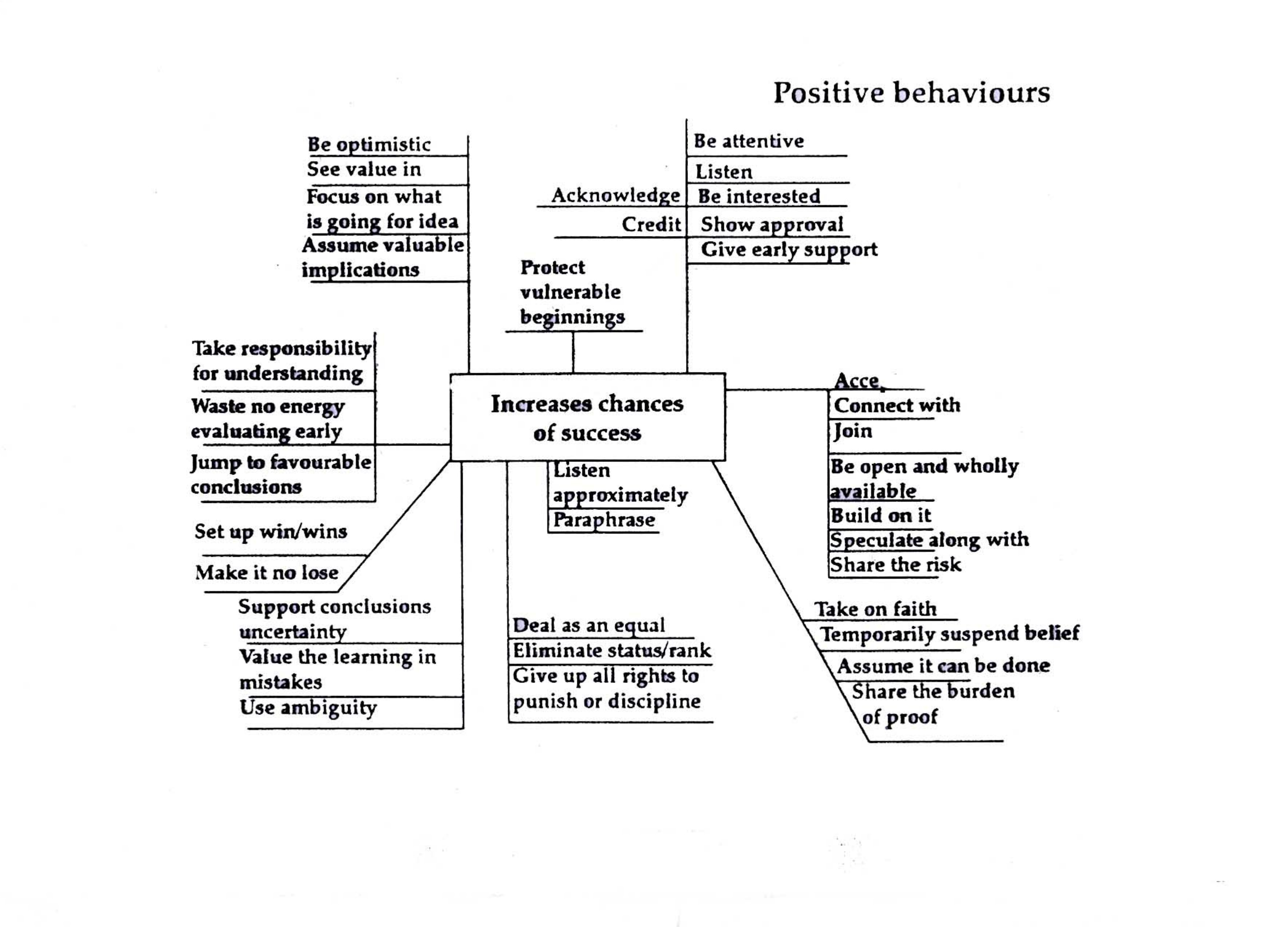

Slide 53
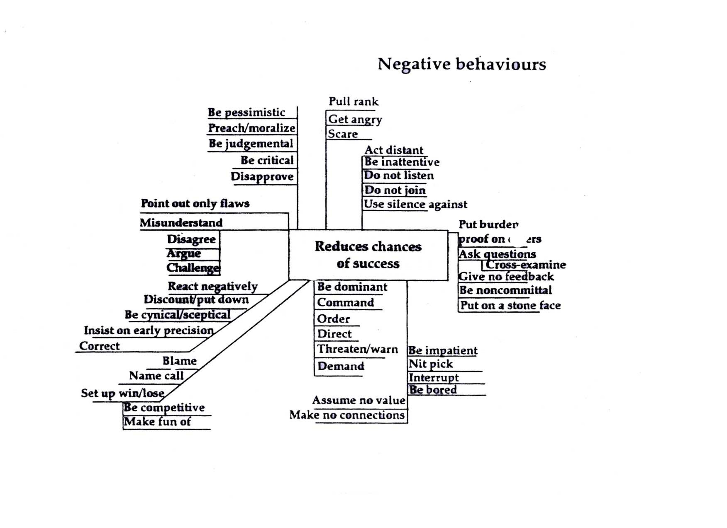

Slide 54
WINNER v/s LOSER
Winners have dreams;
Losers have schemes;
Winners sees the grains;
Losers see the pains;
Winners see the potential;
Losers see the past;
Winners make it happen;
Losers let it happen;
Winners see possibilities;
Losers see problems;
Winners make commitments;
Losers make promises;
Winners are a part of the team;
Losers are apart from the team;

Slide 55
Winners always has a programme;
Loser always has an excuse;
Winner says “Let me do it for you”;
Losers says “that is not my job”.
Winners say ”I must do something”;
Losers say “something must be done”;
Winner sees an answer for every problem;
Loser sees a problem for every answer;
Winner believe in win/win;
Loser believe for them to win, someone has to lose;
winner says “It may be difficult but it is possible”;
loser says” It may be possible but it is too difficult ”
Winner makes a mistake, he says “I was wrong ”;
Loser makes a mistake, he says “It wasn’t my fault”;

Slide 56
THE TOP 20 WAYS TO MOTIVATE EMPLOYEES
Give employees the information they need to do a good job
Provide regular feedback
Ask employees for their input, involve them in decisions that affect their jobs.
Therefore, a company should (#4) establish easy-to-use channels of communication that employees can use to express their questions and concerns and get answers.
Earn from the employees than solves what is that motivates them.
In other words, managers should (#6) learn what on-the-job activities employees choose to do when they have free time

Slide 57
Thank you

